Slide 1
Towards Accepted Behavior Change (ABC) in Academia
The University Cooperative
May 14, 2019
Prof. dr. Lars Tummers
Professor of Public Management & Behavior
School Governance
Utrecht University
@LGTummers

Slide 2
Goals of this presentation
After this presentation, you can…
Describe four ways of changing behavior
Use the model of accepted behavior change to academia

Slide 3
1. How can we change behavior?

Slide 4
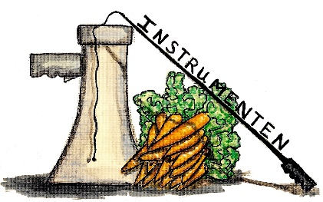
Three traditional ways to change behavior
 | Carrot | Whip | Speech
Discipline | Economics | Law | Communication science
Change via.. | Incentives | Mandates and bans | Persuasion
Slogan | Reward desired behavior! | Make unwanted behavior illegal! | Tell what desired behavior is!
Example in Academia | Get a VIDI and you’ll become Associate Prof. | Make up data and get sacked | Preach for Open Science

Slide 5
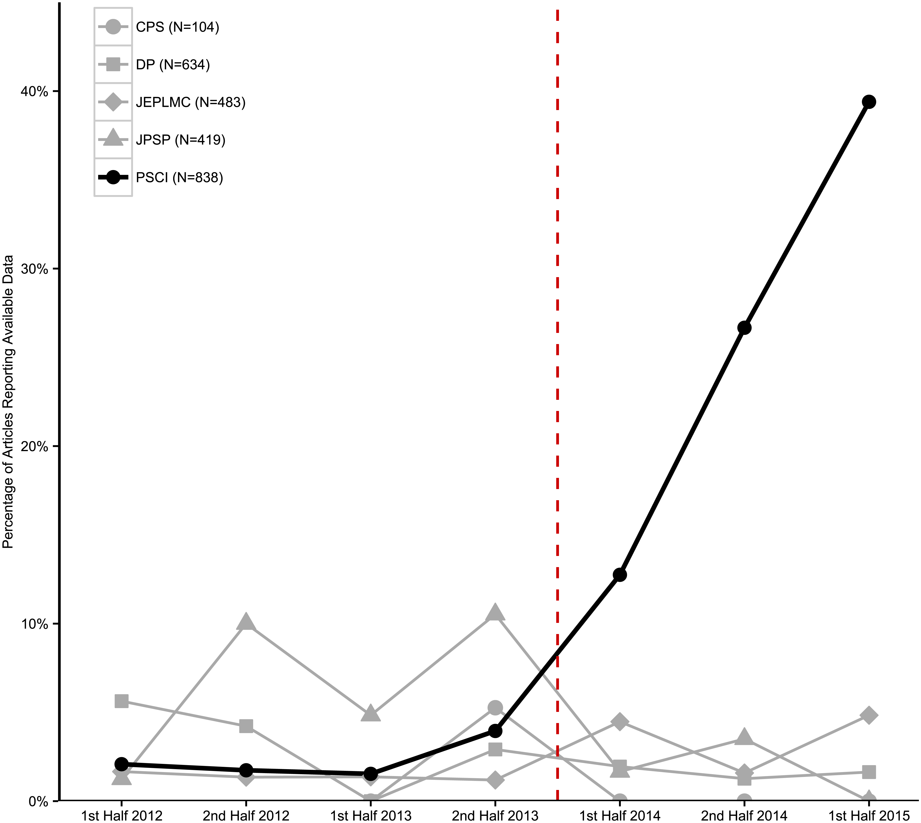


Nudges as a fourth way to change behavior
 | Nudge
Discipline | Psychology
Change via | Choice architecture
Slogan | Make desired behavior easy!
Kidwell, M. C., et al. (2016). Badges to acknowledge open practices: A simple, low-cost, effective method for increasing transparency. PLoS biology, 14(5), e1002456.
Notes:
DUO

Slide 6
2. When is behavior accepted?

Slide 7

A model for Accepted Behavior Change
Focus | Criterium
Behavior Change | 1. Effective behavior change
 | 2. Efficient behavior change
Acceptance | 3. Political support
 | 4. Organizational support
 | 5. Personal support
Tummers, L. G. (2019). Naar gedragen gedragsverandering: Passende interventies in publiek management (oratie). Utrecht: Universiteit Utrecht.

Slide 8
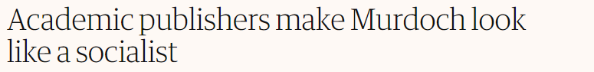
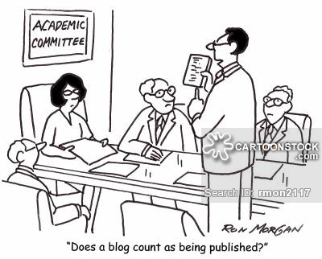
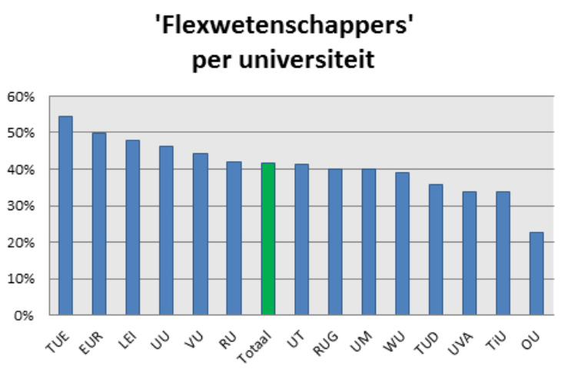
Challenges in Academia where behavior change is needed

Slide 9
Conclusions

Slide 10
Summary
Describe four ways of changing behavior:
Incentives, Bans/Mandates, Information campaigns, Nudges
Use the model of accepted behavior change to academia
Effective, Efficient, and Politically, Organizationally & Personally Supported
If there is one thing you’ll remember, what will it be?

